Slide 1
Chat Bot

Slide 2

Contents
Introduction
Types of chat bot
Data and preprocessing
techniques and evaluation
Accuracy comparison
Real life viewing

Slide 3
Introduction

Slide 4

Introduction
What is chat bot?

Slide 5
Types Of Chat Bot

Slide 6
Types of chat bot
Simple chat bot
Advanced chat bot

Slide 7
Data And Preprocessing

Slide 8
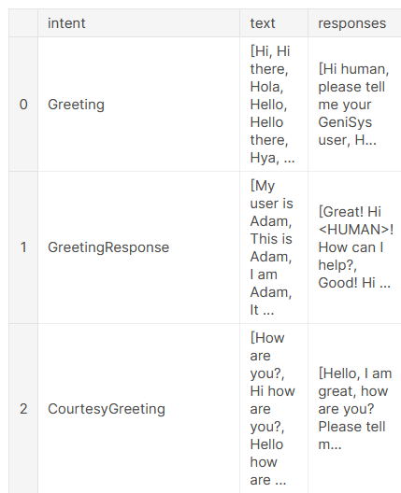
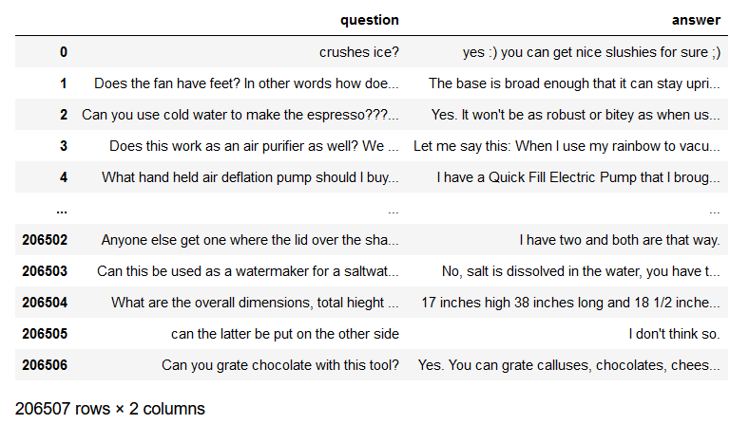
Data
Data of simple chat bot:
http://www.kaggle.com/datasets/elvinagammed/chatbots-intent-recognition-dataset
Data of advanced chat bot:
https://cseweb.ucsd.edu/~jmcauley/datasets/amazon/qa/

Slide 9
Advanced Chat Bot

Slide 10
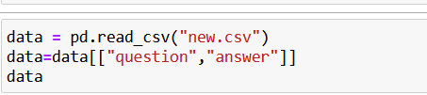
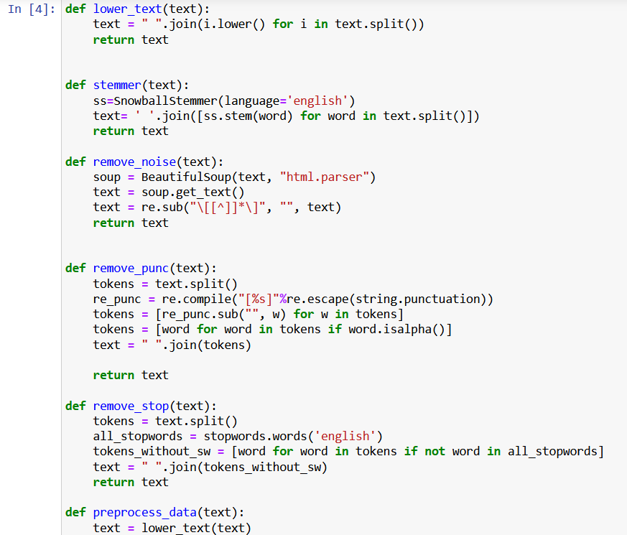
Preprocessing of advanced chat bot
1-select our interested data:
2-start our pre preprocessing:
Lower-text
Stemmer
Remove noise
Remove punctation
Remove stop words

Slide 11
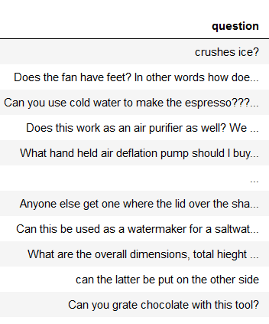
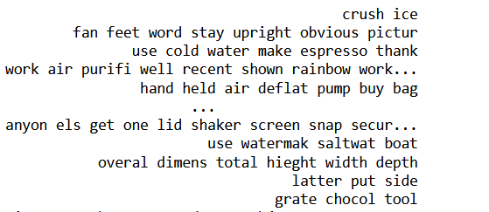
Data before and after preprocessing

Slide 12
Techniques And Evaluation

Slide 13
Techniques And Evaluation
Transformer
Bert

Slide 14

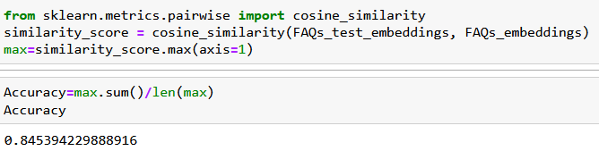
1-Transformer and evaluation
Use transformers to encode our data
use cosin similarity in our test data
Resource(Anton Kozyriev):https://www.kaggle.com/code/antonkozyriev/build-a-chatbot-from-learned-embeddings

Slide 15
2-bert and evaluation
Use Bert to encode our data
use cosin similarity in our test data
Resource(Narendra Prasath):https://www.kaggle.com/code/narendrageek/covid-19-faq-bot-embeddings-bert-ques-similarity

Slide 16
Accuracy Comparison

Slide 17

Transformers
Bert
Accuracy: 84.5%
Accuracy: %

Slide 18
Simple chat bot

Slide 19

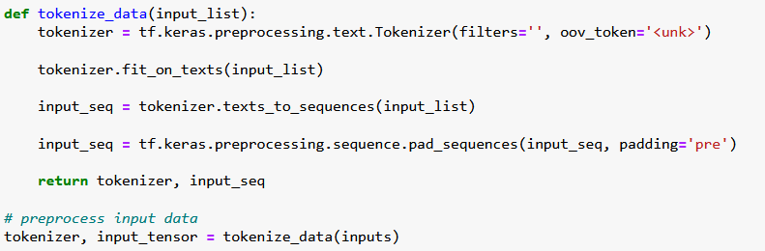
Preprocessing of simple chat bot
Lower-text
Remove noise
Remove punctation
Convert it to sequence using Tokenizer

Slide 20
Build the model

Slide 21
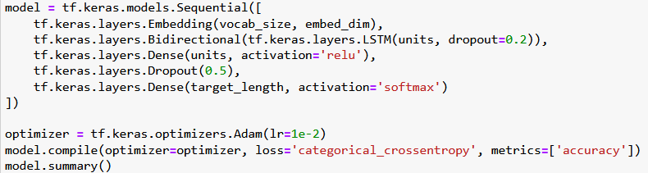
Build the model

Slide 22


Real life viewing

Slide 23
Any questions ?

Slide 24
Thank you !

